Slide 1

APPLIED MATHEMATICAL FOUNDATIONS
Mathematics in Modern Technology
The hidden architectural engine driving artificial intelligence, cybersecurity, graphics, and computing infrastructure.
12 Tech Domains
Core Engineering Pillars

Slide 2


Domain 01
Number Theory: The Shield of Security
Public-Key Cryptography
Prime factorization powering RSA, ECC, HTTPS, and SSH protocols.
Hashing & Blockchains
One-way cryptographic functions securing immutable ledgers and digital signatures.
Error Correction & PRNG
Checksums and Modular arithmetic driving QR codes and pseudorandom generators.

Slide 3



Domain 02
Algebra: Structures, Verification & Querying
Finite Fields (AES)
Relational Algebra
Formal Verification
Galois fields enabling symmetric AES encryption and Reed-Solomon data storage codes.
SQL query optimization engines transforming complex database executions efficiently.
Algebraic logic verifying critical microchip design and mission-critical software.

Slide 4
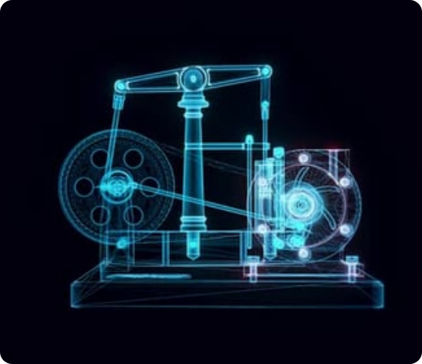
Domain 03
Geometry: Spatial Computing & Vision
3D Graphics & Game Engines
Polygon meshes, ray casting, and spatial coordinates rendering real-time virtual environments.
Computer Vision & AR / VR
Epipolar geometry mapping camera pixels directly to physical 3D world space.
Robotics, CAD & Navigation
Computational geometry guiding 3D printing slicers, GPS triangulation, and spatial awareness.

Slide 5
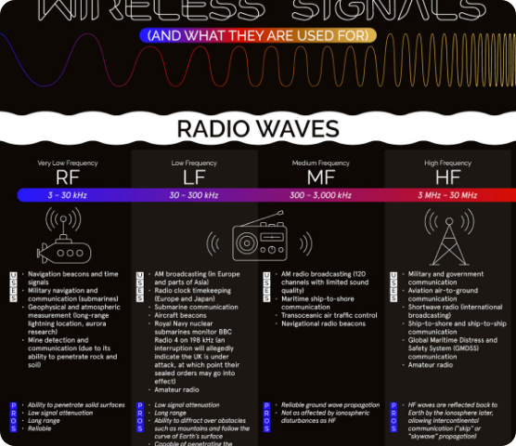
Domain 04
Trigonometry: Waves, Signals & Rotation
Wi-Fi & 5G Communications
Fourier transforms converting sine waves into high-speed wireless packet data.
Digital Signal Processing
Trigonometric codecs compressing raw media into MP3, JPEG, and MP4 formats.
Rotations & Drone Sensors
Euler angles and trigonometric calculations balancing gyroscopes and flight physics.

Slide 6
Domain 05
Calculus & Analysis: Continuous Optimization
Machine Learning Training
Physics Engines & Simulations
Gradient descent and multivariate backpropagation optimizing neural network weights.
Differential calculus simulating continuous motion, fluid dynamics, and collision forces.
Control Systems
Algorithm Analysis
Feedback loops calculating continuously changing inputs for stable automation.
Asymptotic analysis quantifying execution growth rates and Big O complexity bounds.

Slide 7
Domain 06
Topology: Structure, Connectivity & Meshes
Topological Data Analysis
Sensor Coverage & Networks
Uncovering high-dimensional shape structures in massive, unorganized datasets.
Verifying complete spatial coverage and robustness against individual node failure.
Robot Motion Planning
3D Mesh Processing
Configuration spaces ensuring collision-free movement through physical obstacles.
Maintaining surface integrity and hole-free manifolds in graphics modeling.

Slide 8
Domain 07
Logic & Set Theory: Computing Architecture
Hardware Level
Software & Data
CPU & Digital Logic Design
Types, Databases & Solvers
Boolean algebra orchestrating physical logic gates, arithmetic units, and CPU instruction pipelines.
Set theory powering database JOINs, type systems preventing runtime bugs, and SAT solvers proving code safety.
AND, OR, NOT gates $\rightarrow$ Transistor Switches
Venn Intersections $\rightarrow$ SQL Relational Joins

Slide 9
Domain 08
Combinatorics: Counting & Optimization
Key-Space Strength
Data Compression
Test-Case Generation
Permutation and combination math measuring password entropy and cryptographic brute-force resistance.
Huffman coding tree algorithms maximizing storage efficiency by encoding character frequency.
Combinatorial software testing generating minimal input subsets with maximum bug coverage.

Slide 10
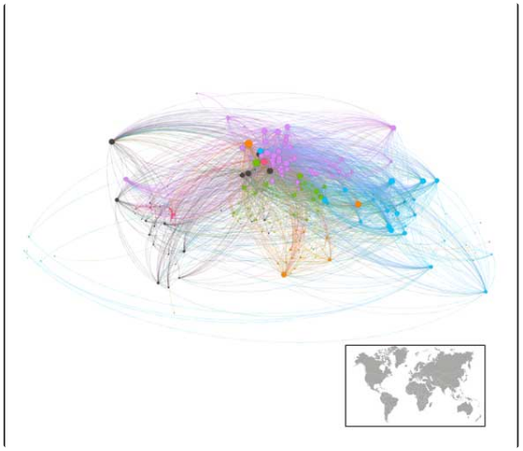
Domain 09
Graph Theory: Connected Networks & Routing
Shortest-Path Navigation
Dijkstra and A* algorithms calculating real-time traffic routes in Google Maps.
Internet Routing & Infrastructure
BGP protocol mapping global internet topology for fast packet delivery.
Social Networks & CI/CD Pipelines
Directed acyclic graphs (DAGs) organizing build tasks and friend recommendations.

Slide 11
Domain 10
Probability & Statistics: AI & Uncertainty
$P(w_n | w_{1..n-1})$
Language Models (LLMs)
Predicting next token probability distributions across multi-billion parameter vocabularies.
A/B Testing & Analytics
Spam & Anomaly Detection
Hypothesis testing and p-values measuring statistical significance in user experiments.
Bayesian inference filtering malicious emails and flagging fraudulent transaction patterns.

Slide 12
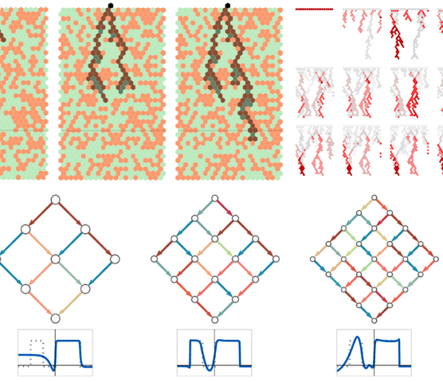
Domain 11
Linear Algebra: The Backbone of AI
Deep Neural Networks
Massive matrix multiplications processing tensor layers inside GPUs and TPUs.
Search Engines (PageRank)
Eigenvectors and eigenvalues calculating web page authority and search rankings.
Graphics Transformations
4x4 affine matrices scaling, rotating, and translating objects in 3D pipelines.

Slide 13
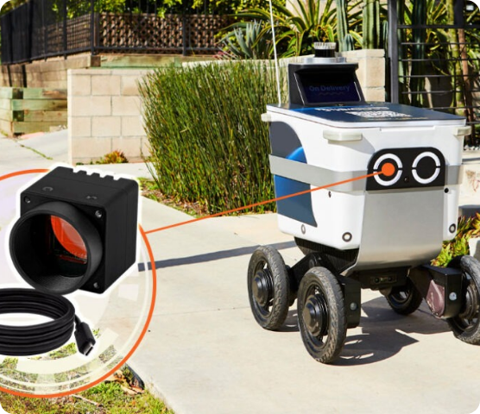
Domain 12
Differential Equations: Dynamic Reality
Autopilot & Drone Controls
PID differential control loops adjusting physical thrust and stability in real time.
Circuit & Electronics Simulation
SPICE software calculating transient voltages across complex microchip circuits.
Engineering Software
Partial differential equations simulating aerodynamics, heat, and structural stress.

Slide 14



Domain 13
Numerical Analysis: Algorithmic Tuning
AI Optimizers (Adam, SGD)
Logistics & Operations
Floating-Point Precision
Numerical iteration algorithms preventing overflow and converging loss functions fast.
Linear programming solving supply chain allocation and cloud resource scheduling.
IEEE 754 arithmetic error analysis preserving accuracy across billions of FLOPS.

Slide 15

Mathematics is the Code Behind the Code
Every modern framework, cloud platform, AI model, and game engine is built on centuries of mathematical discovery.
THANK YOU

Slide 16






Image Sources
https://as2.ftcdn.net/v2/jpg/18/82/82/25/1000_F_1882822515_eNbhijLsDwgVqcS3XGbOkLHPG7RJBtzA.jpg
Source: www.europosters.pt
https://elements-resized.envatousercontent.com/elements-video-cover-images/files/1ce2aeb6-8f41-4646-9188-c58c67db0301/inline_image_preview.jpg?w=500&cf_fit=cover&q=85&format=auto&s=ffc56f4a3236d73c284cb73a1b2be7ea9cb73574023d7e76ce7d76ff7a666881
Source: elements.envato.com
https://www.ooma.com/wp-content/uploads/wireless-signals-7_thumb.jpg
Source: www.ooma.com
https://www.ciat.org/wp-content/uploads/2019/01/2019-sarralde-bdata2.jpg
Source: www.ciat.org
https://content.wolfram.com/sites/43/2024/08/sw-ml-hero-v3.png
Source: writings.stephenwolfram.com
https://www.technexion.com/wp-content/uploads/2025/08/delivery-robot-1024x585.jpg
Source: www.technexion.com

